Slide 1
The Alliance

Slide 2
CVS & Microsoft Alliance
Cloud Training Resources & Credentials/Certifications
Microsoft Azure
Google Cloud Platform
Amazon Web Services

Slide 3

The Alliance

Slide 4
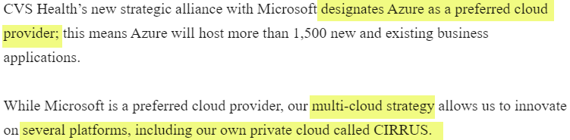
The Alliance

Slide 5
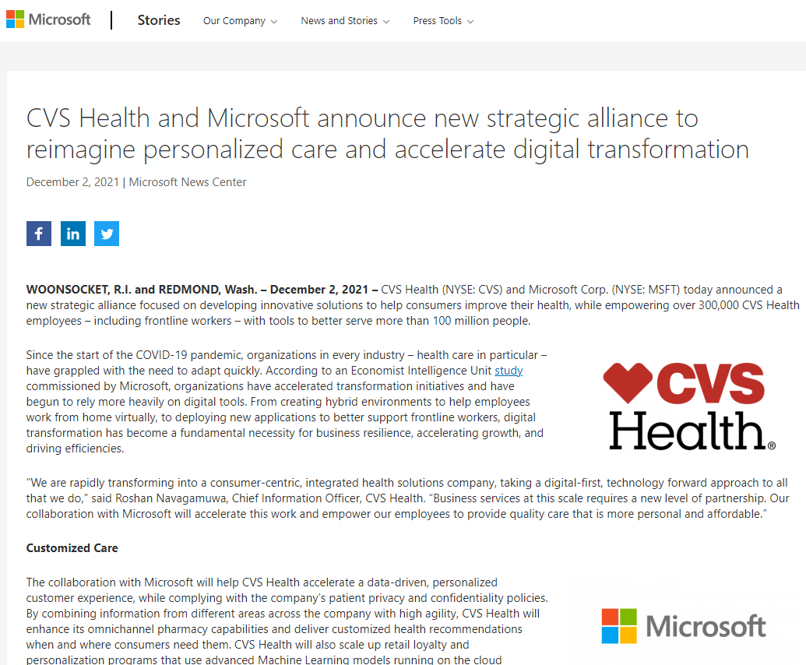
The Alliance

Slide 6
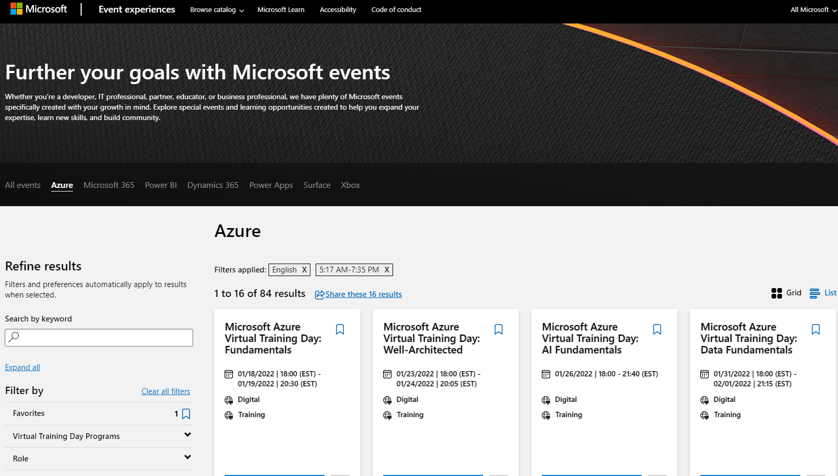
Microsoft Azure Training

Slide 7
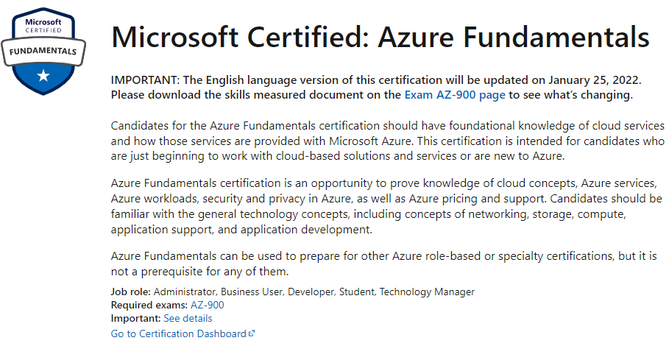
Microsoft Azure Credential

Slide 8
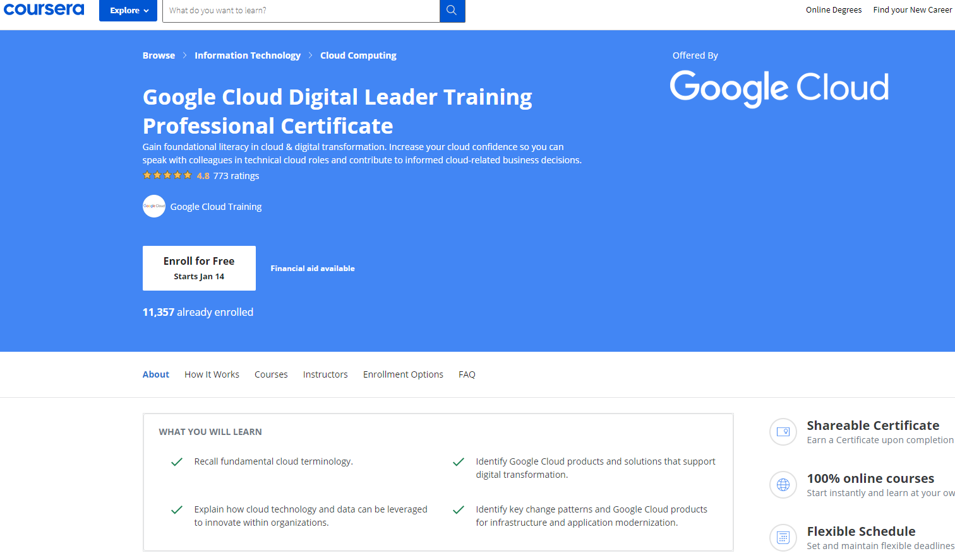
Google Cloud Platform Training

Slide 9
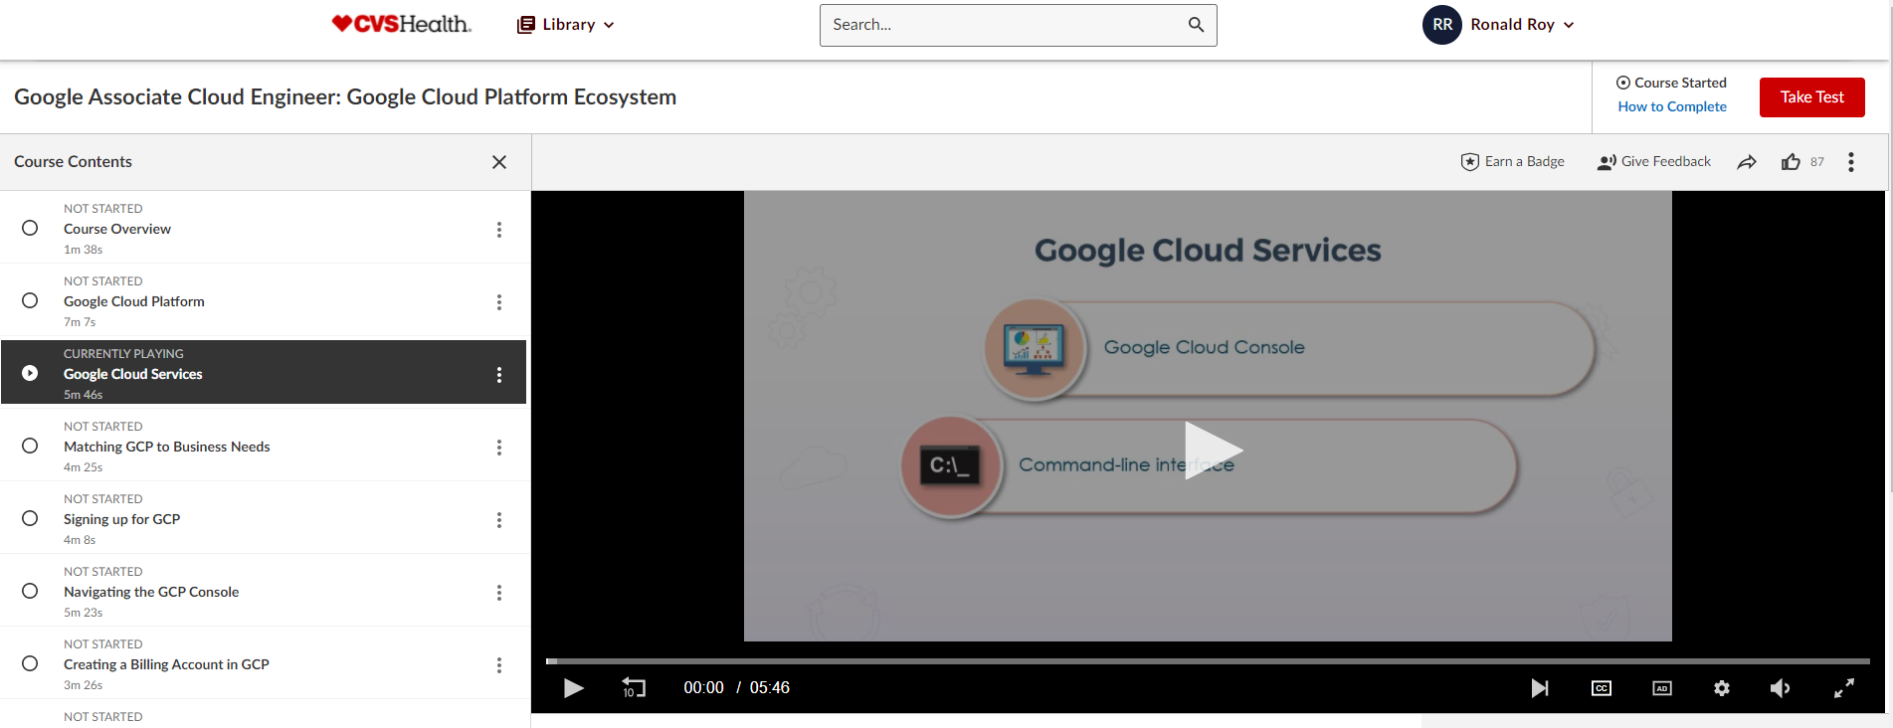
Google Cloud Platform – Training – SAI Contribution

Slide 10
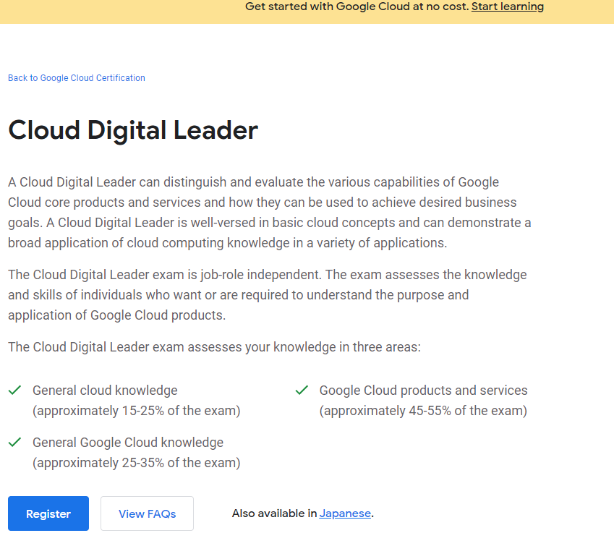
Google Cloud Platform Credential

Slide 11
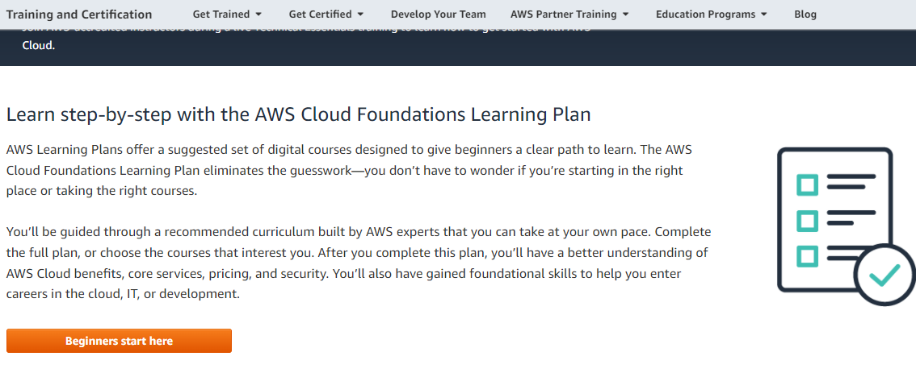
Amazon Web Services - Training

Slide 12
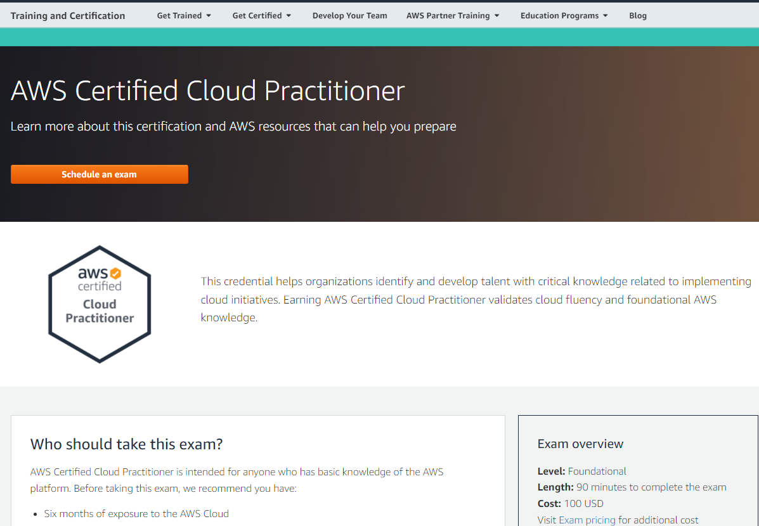
Amazon Web Services - Certification

Slide 13
Summary
Cloud Platform | Credential | Benefit | Duration | Cost | Exam Cost
Microsoft Azure | Microsoft Azure Fundamentals | Certification is an opportunity to prove knowledge of cloud concepts, Azure services, Azure workloads, security and privacy in Azure, as well as Azure pricing and support. | 5.5 hours | Free | Free
Amazon Web Services | AWS Certified Cloud Practitioner | Credential helps organizations identify and develop talent with critical knowledge related to implementing cloud initiatives. Earning AWS Certified Cloud Practitioner validates cloud fluency and foundational AWS knowledge. | 8 hours | Free | $100
Google Cloud Platform | Cloud Digital Leader | The Cloud Digital Leader learning path builds cloud literacy, and validates knowledge to help prepare for the Google Cloud Digital Leader certification exam. | 8 Hours | Free | $99

Slide 14
Feedback / Questions

